Slide 1
Lecture 3: Engineering of Software
based on Chapter 3

Slide 2
Outline
Software
Software Projects
Software Engineering
SE Ethics
Principles of SE

Slide 3
I. Introduction to Software (SW)
Software (IEEE): collection of programs, procedures, rules, and associated documentation and data.
Let’s discuss the program
SOFTWARE ENGINEERING

Slide 4
Introduction to Software (SW)
Question: If you have to write a 10,000 line program in C to solve a problem, how long will it take?
Answer: generally range from 2-4 months
Let us analyze the productivity
  Productivity = (output resources)/(input resources)
  Lines Of Code (LOC) is considered output
  Input resources is effort - Person Months (PM)
    overhead cost is modeled in rate for person month
  Though not perfect, some productivity measure is needed, as project has to keep it high

Slide 5
Introduction to Software (SW)
The productivity is 2.5-5 KLOC/PM
  10,000/2 = 5 KLOC/PM
Question: What is the productivity in a typical commercial SW organization ?
  A: Between 100 to 1000 LOC/PM
Question: Why is it low, when your productivity is so high? (people like you work in the industry)
  A: What the student is building and what the industry builds are two different things
Abbreviations
  PM – Person Month
  KLOC – 1000 Lines of Code
SOFTWARE ENGINEERING

Slide 6
Introduction to Software (SW)
In a university a student system is built while the commercial organization builds industrial strength software
What is the difference between a student program and industrial strength software for the same problem?
SOFTWARE ENGINEERING

Slide 7
Introduction to Software (SW)
Student
Developer is the user
  Bugs are tolerable
  User Interface not important
  No documentation
Industrial Strength
Others are the users
  Bugs not tolerated
  User Interface v. implementation issue
  Documents needed for the user as well as for the organization and the project
SOFTWARE ENGINEERING

Slide 8
Software…
Student
SW not in critical use
Reliability, robustness not important
No investment
Don’t care about portability
Industrial Strength
Supports important functions / business
Reliability , robustness are very important
Heavy investment
Portability is a key issue here
SOFTWARE ENGINEERING

Slide 9
Industrial strength software
Student programs & industrial strength software are two different things
Key difference is in quality (including usability, reliability, portability, etc.)
  High quality requires heavy testing, which consumes 30-50% of total development effort
  Development is broken into stages such that bugs can be detected in each
  Good User Interface, backup, fault-tolerance, following of standards etc increase the size for the same functionality
SOFTWARE ENGINEERING

Slide 10
Industrial strength software
Brooks rule of thumb: Industrial strength sw costs 10 time more than student sw
Domain of SW Engineering: Industrial strength SW
In SW Engineering and in this course, software means industrial strength software
SOFTWARE ENGINEERING

Slide 11
Software is Expensive
Let us look at costs involved
  Productivity = 500 LOC/PM
  Cost to the company = $10K/PM
  Cost per LOC = $20 ($10,000/500)
  I.e, each line of delivered code costs about $20.
A simple application for a business may have 20KLOC to 50KLOC
  Cost = $100K to $1Million ($20 * 50,000 = $1M)
  Can easily run on $10K-$20K hardware
  So HW costs in an IT solution are small compared to SW costs.
SOFTWARE ENGINEERING

Slide 12
Software is Expensive…
The HW/SW ratio for a computer system has shown a reversal from the early years.
  In 50s , HW:SW :: 80:20
  In 80s , HW:SW :: 20:80
So , SW is very expensive
  Importance of optimizing HW is not much
  More important to optimize SW
SOFTWARE ENGINEERING

Slide 13
Software Projects
Key success factors:
  User involvement
  Executive management support
  Clear requirement statements
  Proper planning
Top failure reasons:
  Lack of user input
  Incomplete requirements
  Changing requirements

Slide 14
Software Projects: Late & Unreliable
Facts: 20-25% of SW projects never complete
  Because after some time they realize that the final cost will be much higher
Many companies report runaways
  budget & cost out of control
  hire consulting companies to help control them
One defense survey found that 70% of the equipment problems are due to SW
Many examples of software failures
SOFTWARE ENGINEERING

Slide 15
Why do projects fail so often (1)
Unrealistic or unarticulated project goals
Inaccurate estimates of needed resources
Badly defined system requirements
Poor reporting of the project's status
Unmanaged risks
Poor communication among customers, developers, and users
SOFTWARE ENGINEERING

Slide 16
Why do projects fail so often(2)
Use of immature technology
Inability to handle the project's complexity
Sloppy development practices
Poor project management
Stakeholder politics
Commercial pressures
SOFTWARE ENGINEERING

Slide 17
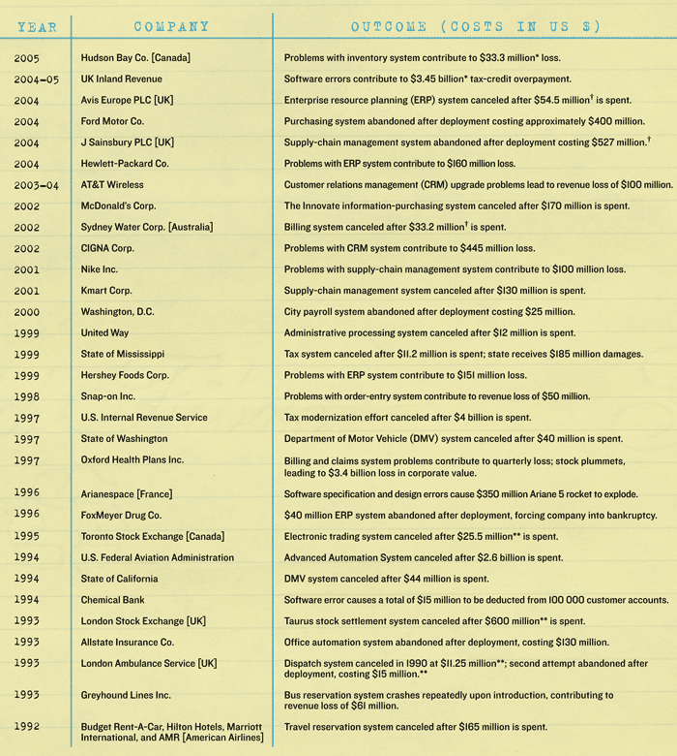
SOFTWARE ENGINEERING

Slide 18
Why Software Projects Fail?
400 projects in the U.S., Australia, and Chile http://www.developerdotstar.com/mag/articles/software_success_failure.html
  60% of organizations have no process to measure benefits
  86% of projects had a business case, but 60% ignored it
  33% of projects said they had no risks, but 62% of those failed
  49% of organizations have had (one or more) project failures
  In one-third of the projects, the project manager had no say in schedule/budget targets
  75% of projects were underestimated, none were overestimated
  5% of projects had no project manager; 16% changed project manager at least once (and that was correlated with project failure)
SOFTWARE ENGINEERING

Slide 19
Unreliable…
SW failures are different from failures of mechanical or electrical systems
In software, failures are not due to aging related problems
Failures occur due to bugs or errors that get introduced during development
I.e. the bug that causes a failure exists from start, only manifests later
SOFTWARE ENGINEERING

Slide 20
Maintenance
Once SW delivered, it enters maintenance phase
Why is maintenance needed for SW when it does not wear with age?
  Residual errors requiring corrective maintenance
  Upgrades and environment changes – adaptive maintenance
Over SW life, maintenance can cost more than the development cost of SW
SOFTWARE ENGINEERING

Slide 21
Source of Software Product Problems
Code errors : 38.33%
Design errors : 24.17%
Documentation errors : 13.33%
Requirements errors : 12.50%
Bad-fix errors : 11.67%
Should we worry about coding more or requirements more, why?

Slide 22
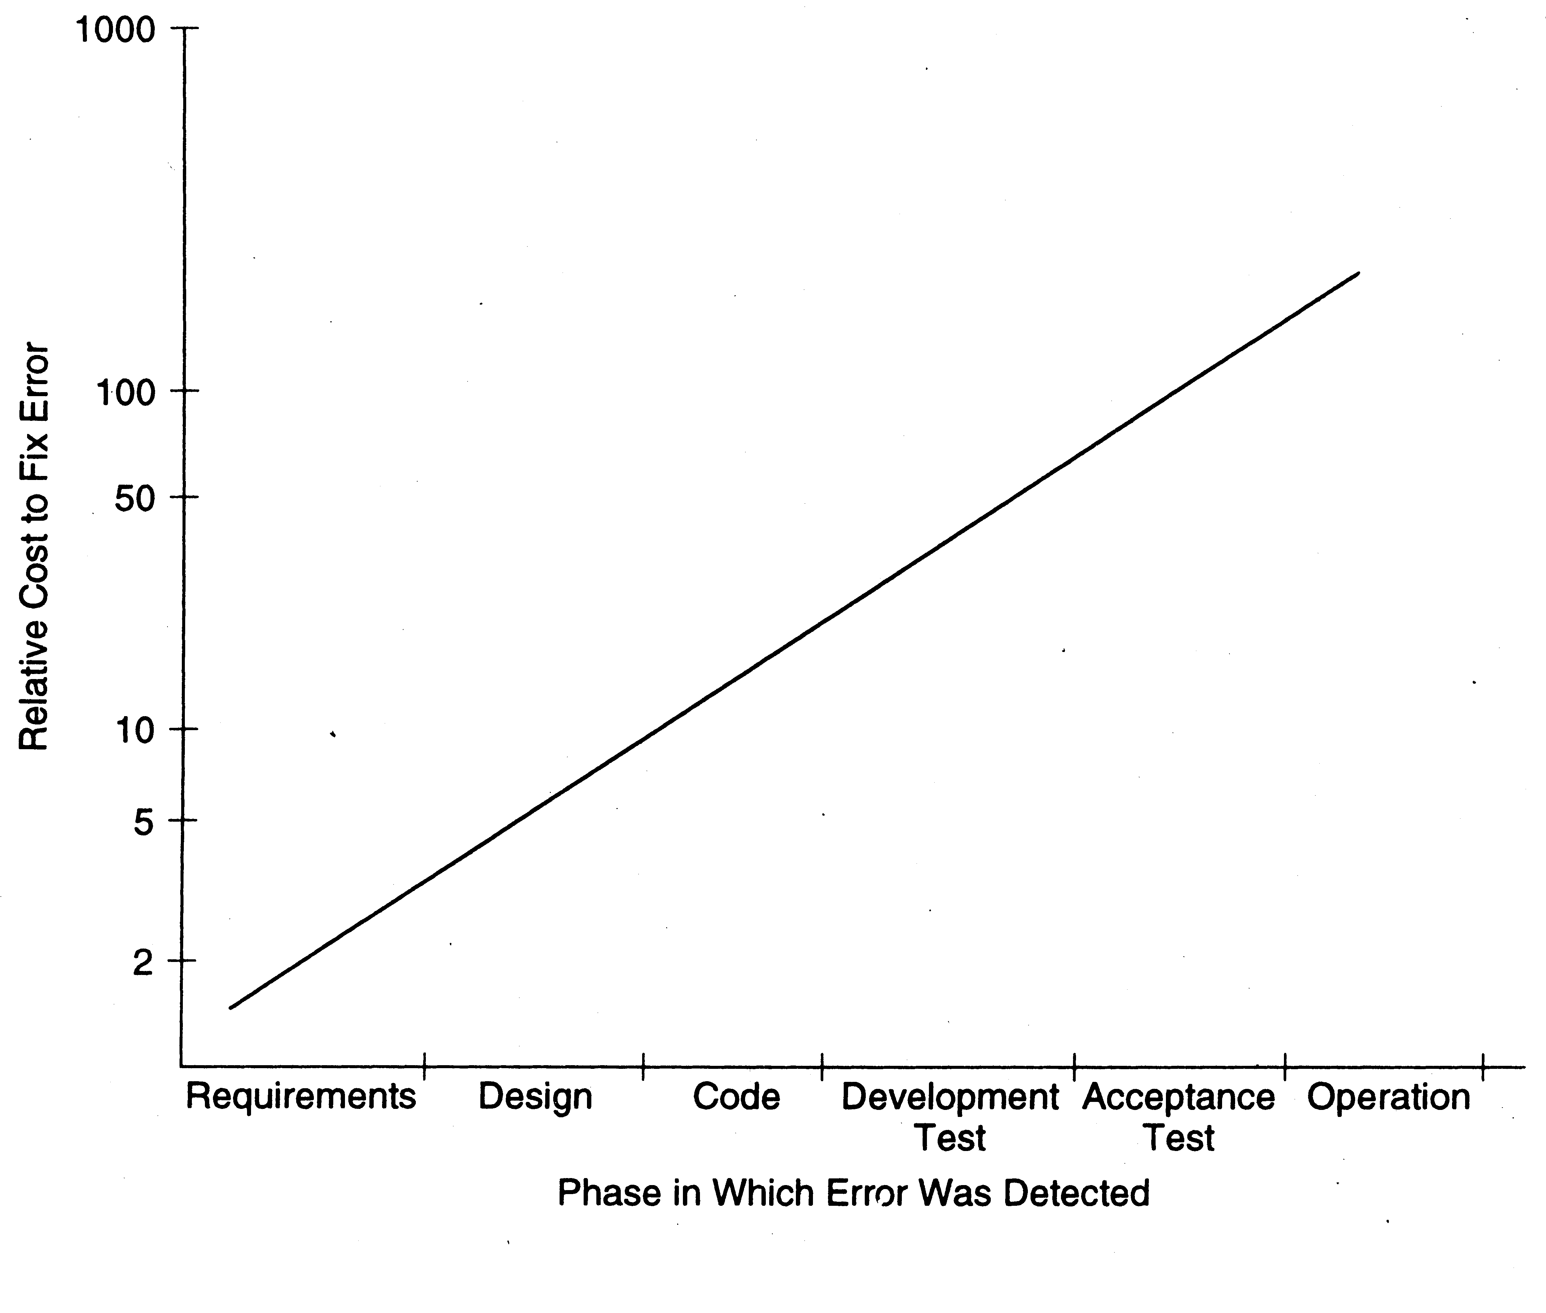
Early Defect Removal…
Sofware Process

Slide 23
II. Software Engineering
What is needed to develop large and complex software products and what is needed to control such projects ?
More “discipline” is needed in this field:
  “SOFTWARE ENGINEERING”
(NATO conference - 1968)

Slide 24
What is Software Engineering
Sommerville – “an engineering discipline whose focus is the cost-effective development of high quality software system”
Pfleeger – application of computing tools to solving problems
CMU/SEI-90-TR-003 – “form of engineering that applies the principles of computer science and mathematics to achieving cost-effective solutions to software problems
IEEE std 610-1990 – “application of a systematic, disciplined, quantifiable approach to the development, operation, and maintenance of software”

Slide 25
Software Engineering
(Tsui and Karam)
Software Engineering is a broad field that touches upon all aspects of developing and supporting a software system, spanning across the following key areas:
  1. Technical and business processes
  2. Specific methodologies and techniques
  3. Product characterization and metrics for measurements
  4. People skills and team work
  5. Project coordination and management

Slide 26
Software Engineering Profession
Software is a serious business
  Reached $180 billion in 2000
  It is ubiquitous across multiple industries
Software is a commodity of increasing “Value”
The business of software has graduated from a “garage” operation to an “enterprise” profession
We need to treat software engineering as an engineering profession

Slide 27
SE ethics: IEEE-CS/ACM Version 5.2 Report
8 principles for ethics and professional practices in software engineering
  Software engineers shall act consistently with the public interest
  Software engineers shall act in a manner that is in the best interest of their client and employer, consistent with the public interest
  Software engineers shall ensure that their products and related modifications meet the highest professional standards possible
  Software engineers shall maintain integrity and independence in their professional judgment
  Software engineering managers and leaders shall subscribe to and promote an ethical approach to the management of software development and maintenance
  Software engineers shall advance the integrity and reputation of the profession consistent with the public interest
  Software engineers shall be fair to and supportive of their colleagues
  Software engineers shall participate in lifelong learning regarding the practice of their profession and shall promote an ethical approach to the practice of the profession.

Slide 28
Professional Behaviour:
A Simple Set of Behavioral Rules
Respect others
Strive for fairness
Perform to one’s best capability
Follow the law

Slide 29
Principles of Software Engineering
Different from other engineering disciplines such as civil or mechanical, there is no one set of universal principles in software engineering that is agreed to by everyone.
There are, however, several that are well received and respected.
  Davis’s Principles
  Royce’s Principles
  Wasserman’s Concepts

Slide 30
Davis’s Early 15 principles
Make quality number 1
High quality software is possible
Give products to customers early
Determine the problem before writing the requirements
Evaluate design alternatives
Use an appropriate process model
Use different languages for different phases
Minimize intellectual distances
Put techniques before tools
Get it right before you make it faster
Inspect code
Good management is more important than good technology
People are the key to success
Follow with care
Take responsibility
Are these consistent within themselves - - -
How “key” is “people are key to success”
What do you think?

Slide 31
Royce’s More Modern Principles
Base the process on an architecture first approach
Establish iterative process --- address risk early
Emphasize component based development to reduce effort
Establish change management
Use round-trip engineering – a form of iterative process
Use model-based and machine processable notations for design
Establish process for quality control and project assessment
Use approach that allows artifacts to be demonstrated early
Plan to have incremental releases
Establish a configurable process to suit the needs
Agree with these? Why ?

Slide 32
Wasserman’s Fundamental Concepts
Abstraction
Analysis and design methods and notation
User interface prototyping
Modularity and architecture
Reuse
Life cycle and process
Metrics
Tools and integrated environment
Important concepts - - - how do they relate to earlier listed principles from Davis or Royce?

Slide 33
How about principles for Support ?
Is there a need to come up with some principles or rules for supporting and maintaining released software? What about:
  customer is always right
  problem resolution turn around time is key
  problem fix or resolution quality is vital
Any others? Do resolution speed and quality conflict with each other?

